Slide 1


PIMPRI CHINCHWAD COLLEGE OF ENGINEERING
Topic
OMR Sheet Evaluation Using
Image Processing
Domain: Artificial Intelligence, Computer Vision
Language: Python
Libraries: OpenCV, NumPy, Pandas
Web Application: HTML, CSS, Bootstrap, JavaScript, Flask
Database: SQLite

Slide 2
Problem Statement
Manual evaluation has a chance of errors.
Economical solution to evaluate OMR sheets using Image Processing
Source Of The Problem Statement
Scanning machines are heavy on the pocket.
OMR sheets are used by colleges, schools, and private institutes.

Slide 3
Proposed System
OMR Sheet
Marked OMR
(Input Image)
Image Processing Techniques
Compare with Answer Key
Display Result
Insert Answer Key

Slide 4
Proposed System
Input Image
Convert RGB to Grayscale
Warp Perspective
Applying Threshold
Calculate Result & Display
Detect Biggest Rectangle & it’s Corner Point
Edge Detection
Contour Detection
Smoothing Image

Slide 5
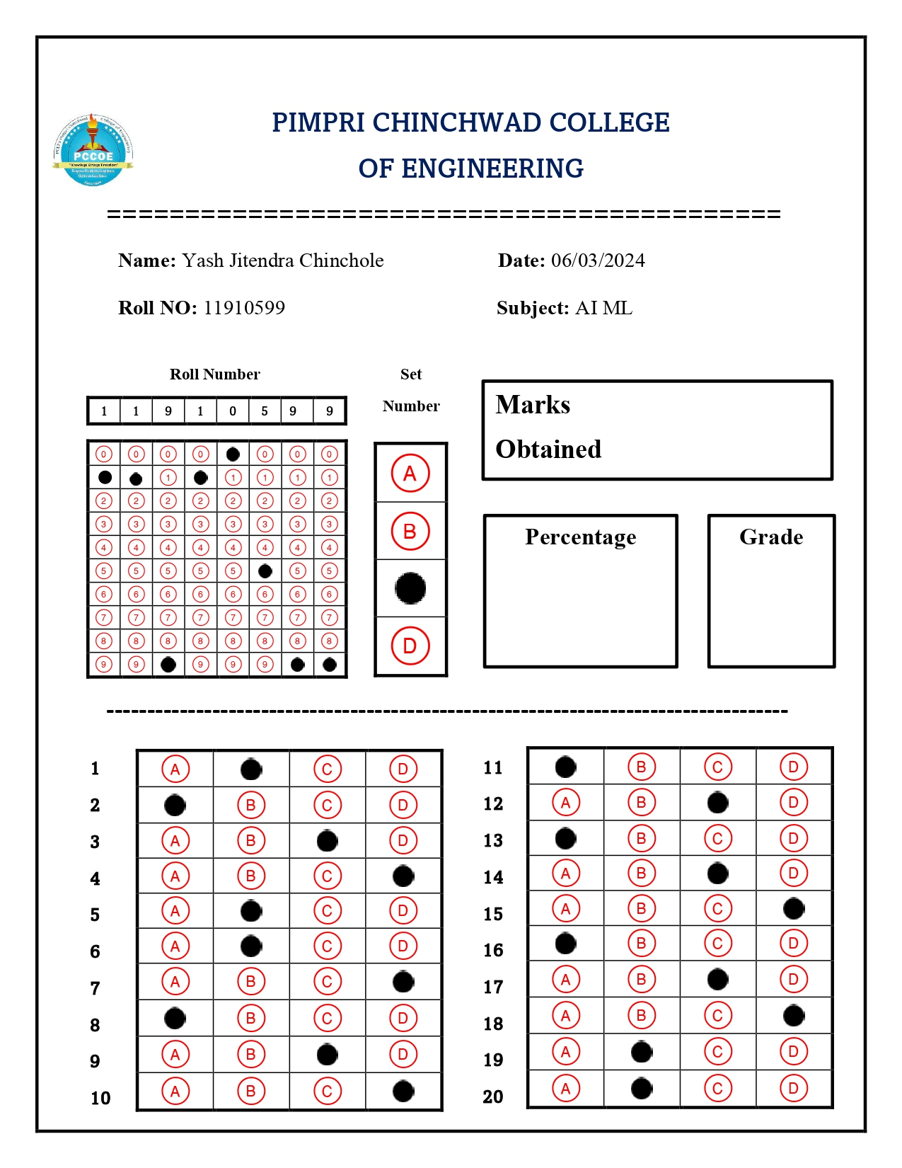
Input Image

Slide 6
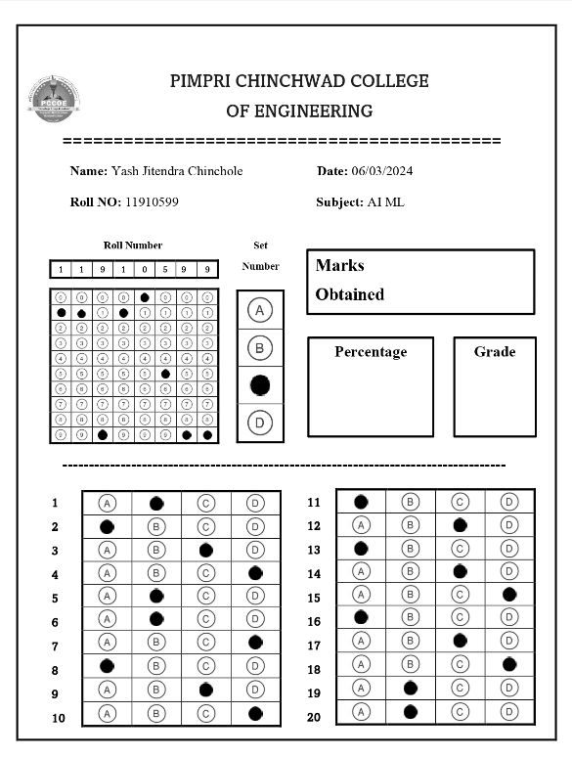
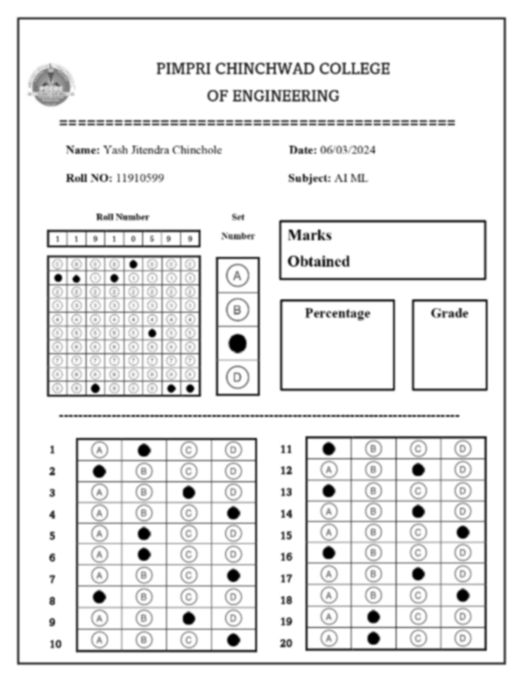
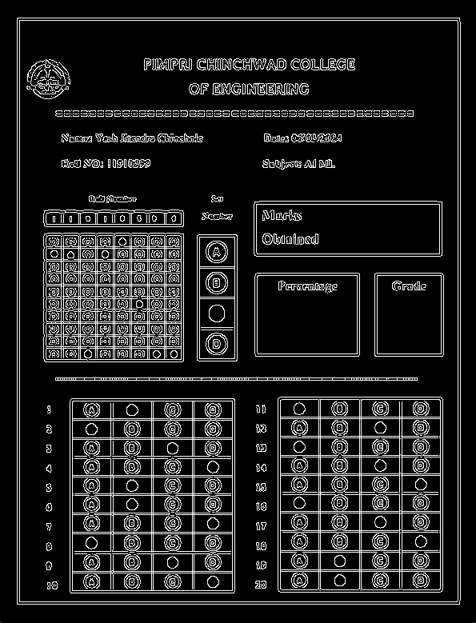
Preprocessing Techniques
Gray Scale
Blur Image
Edge Detection

Slide 7
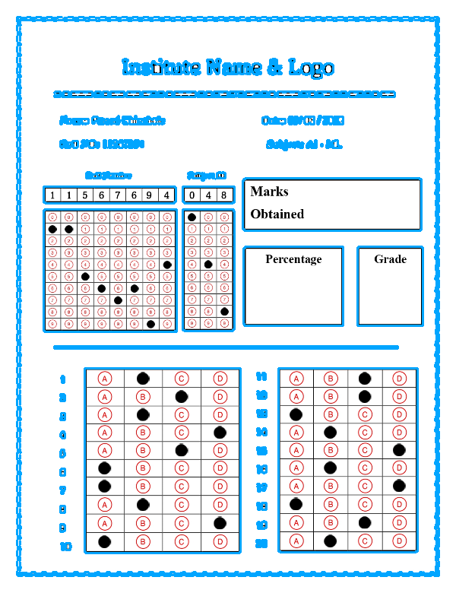
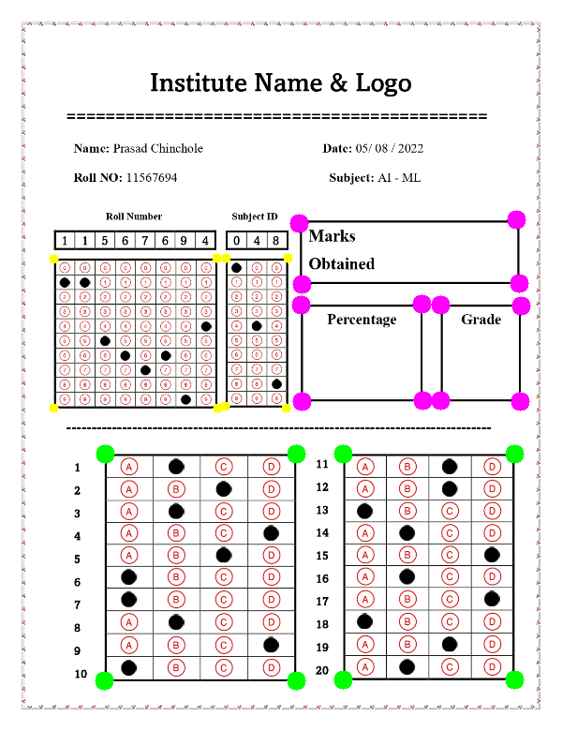
Contour Detection
Contours
Biggest Contours

Slide 8
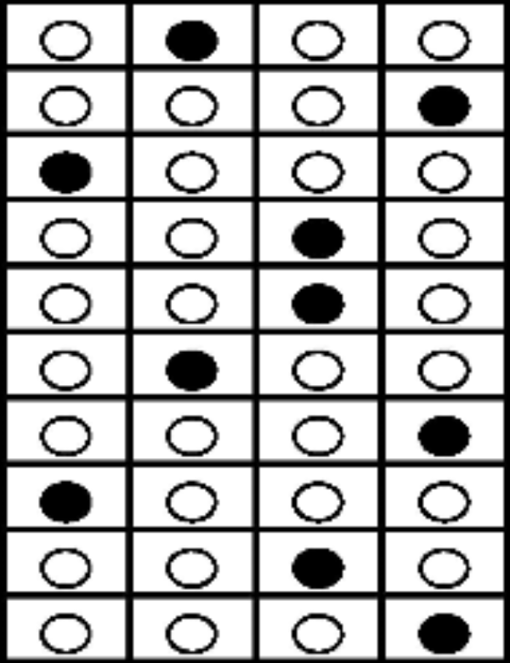
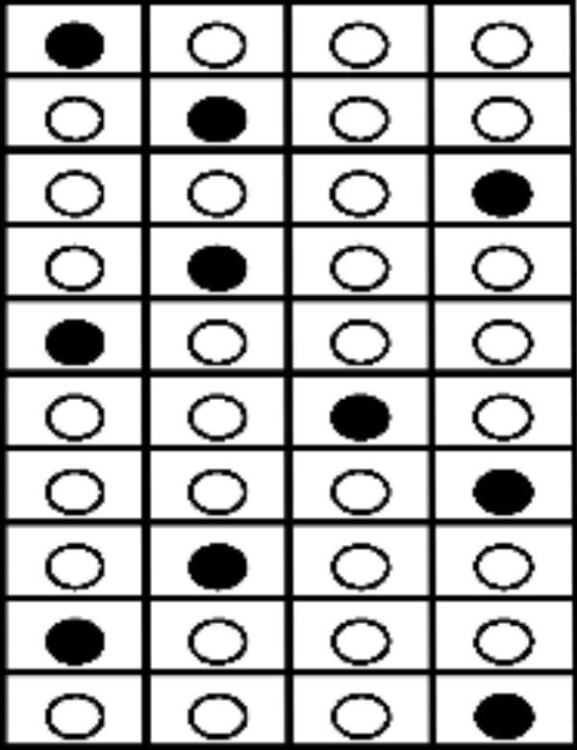
Warp Perspective
Warp Perspective Of the Marking Area - 1
Warp Perspective Of the Marking Area - 2

Slide 9
Box

Slide 10
Non-Zero Pixel Values Of Each Box
3224
4569
3251
3234
3380
3343
3388
4767
4651
3196
3265
3269
3220
3182
4626
3220
3349
3302
4753
3356
3241
4559
3244
3255
3482
3443
3499
4866
4662
3209
3284
3281
3203
3174
4622
3212
3384
3359
3398
4773

Slide 11
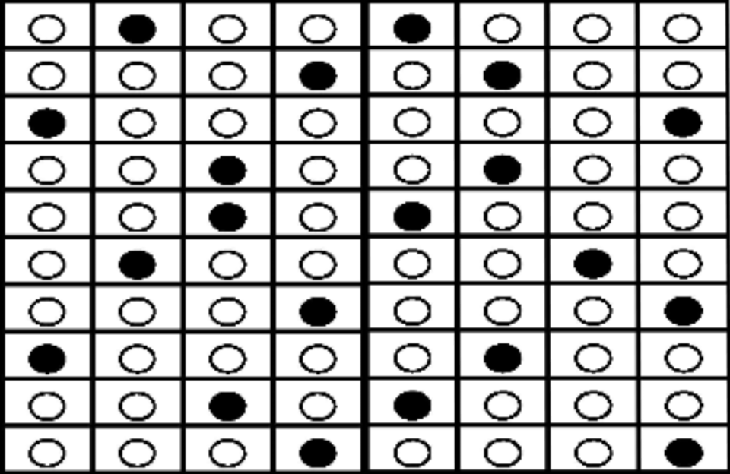
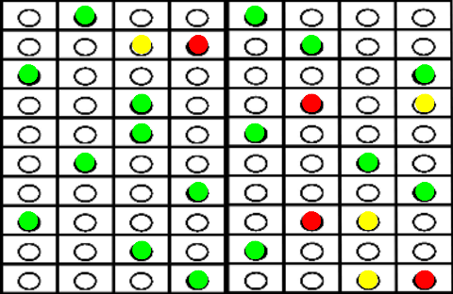
Check the OMR
Marked Area
OMR Checking

Slide 12
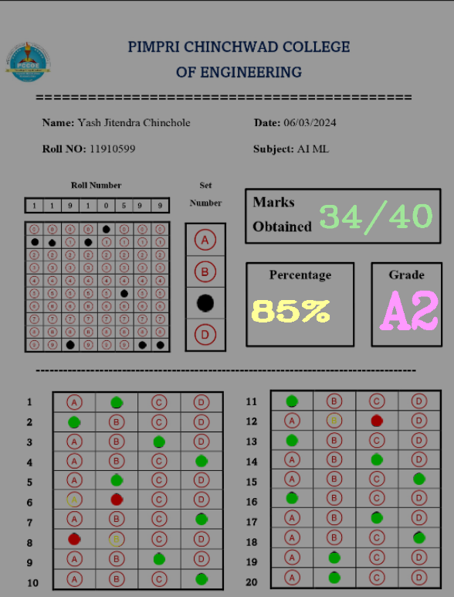
Final Output

Slide 13
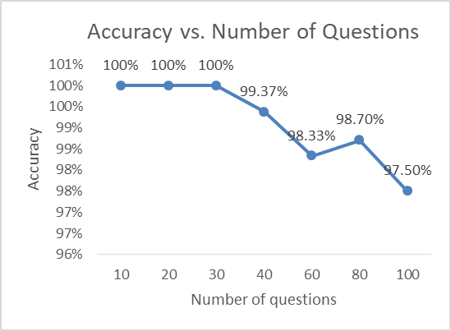
Experimentation And Results
Type of OMR | Number of Questions | Number of OMRs | Accuracy
Type 1 | 10 | 50 | 100%
Type 2 | 20 | 50 | 100%
Type 3 | 30 | 50 | 100%
Type 4 | 40 | 50 | 99.37%
Type 5 | 60 | 40 | 98.33%
Type 6 | 80 | 30 | 98.70%
Type 7 | 100 | 30 | 97.50%

Slide 14
Thank You

